Slide 1

Naïve Bayes Classifier

Slide 2
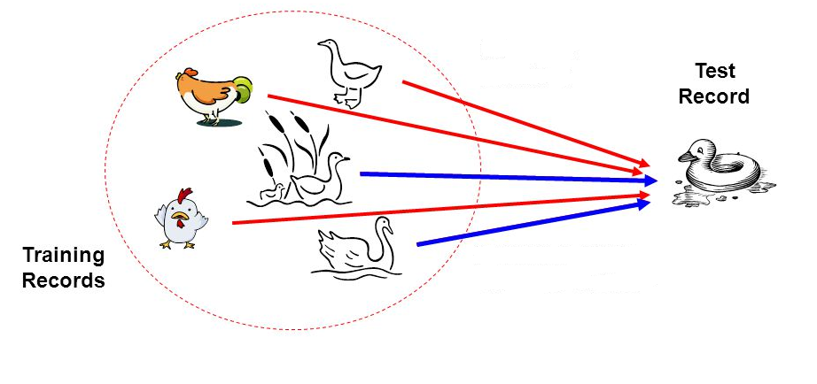
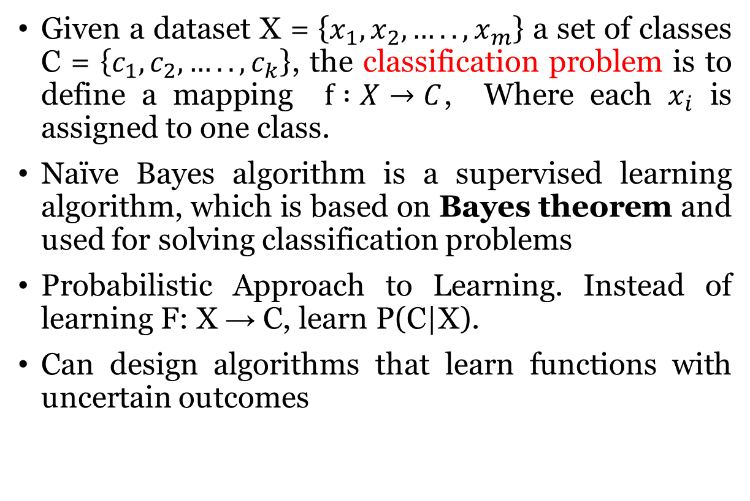
Naïve Bayes Classifier
Given a dataset X = $\left\{x_{1},x_{2},…..,x_{m}\right\}$ a set of classes C = $\left\{c_{1},c_{2},…..,c_{k}\right\}$, the classification problem is to define a mapping $f :X→C$, Where each $x_{i}$ is assigned to one class.
Naïve Bayes algorithm is a supervised learning algorithm, which is based on Bayes theorem and used for solving classification problems
Probabilistic Approach to Learning. Instead of learning F: X → C, learn P(C|X).
Can design algorithms that learn functions with uncertain outcomes

Slide 3
Applications
Face Recognition
Weather Prediction
Medical Diagnosis
News Classification

Slide 4
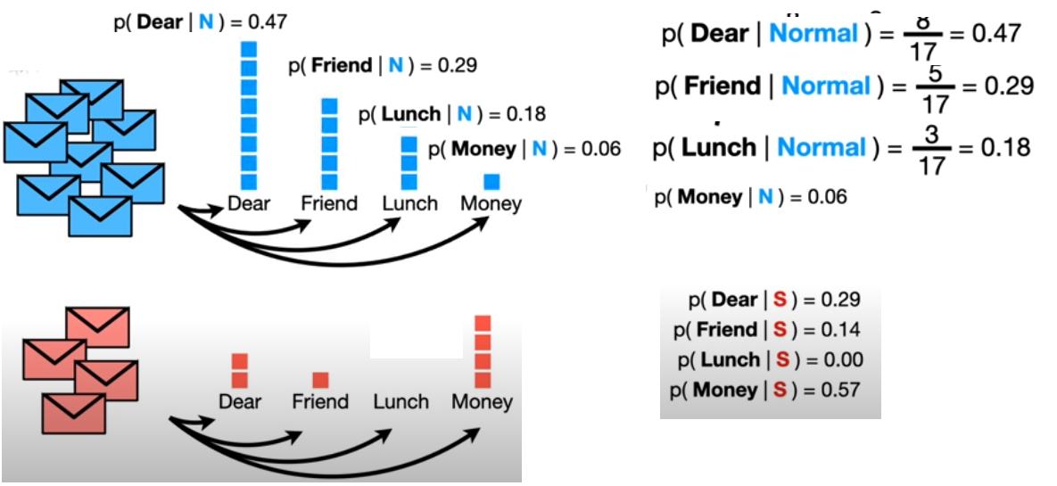
Example: Normal / Spam mail Classification
Slides taken from Josh Starmer, statquest

Slide 5
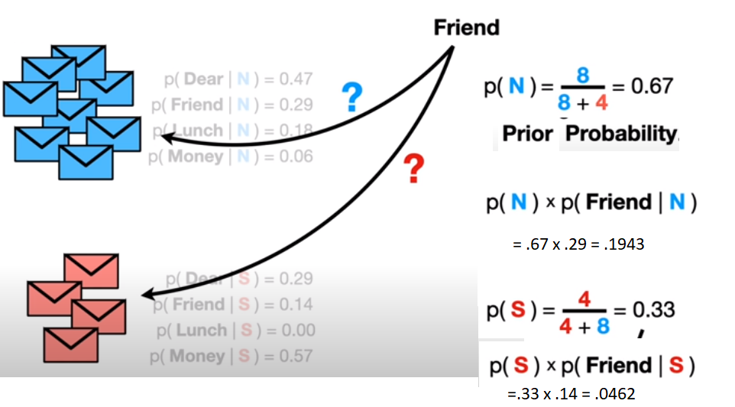
Example: Normal / Spam mail Classification
Slides taken from Josh Starmer, statquest

Slide 6
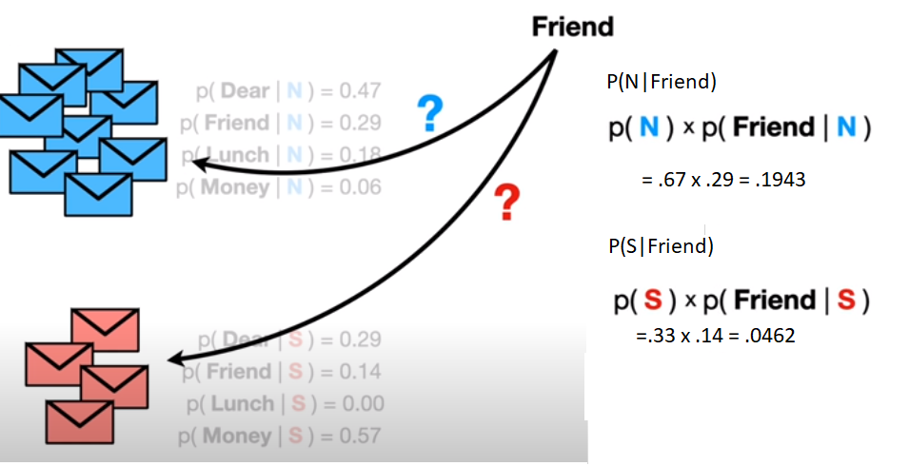
Example: Normal / Spam mail Classification
Slides taken from Josh Starmer, statquest

Slide 7
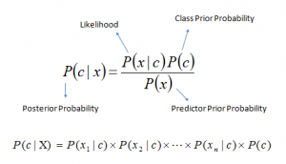
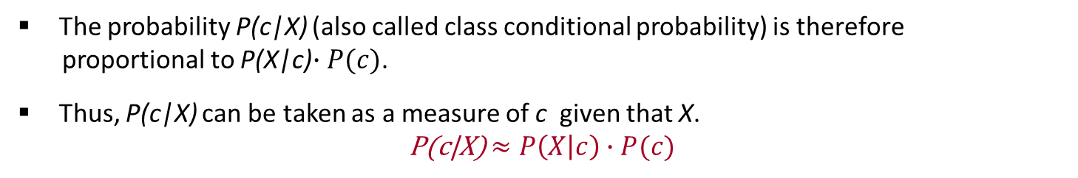

Naïve Bayesian Classifier
Suppose, c is a class variable and X = $\left\{X1,X_{2},…..,X_{n}\right\}$ is a set of attributes, with instance of c.
Naïve Bayesian classifier calculate this posterior probability using Bayes’ theorem
The probability P(c|X) (also called class conditional probability) is therefore
proportional to P(X|c)$∙P(c)$.
Thus, P(c|X) can be taken as a measure of c given that X.
P(c|X) $≈P\left(X | c\right)∙P(c)$

Slide 8
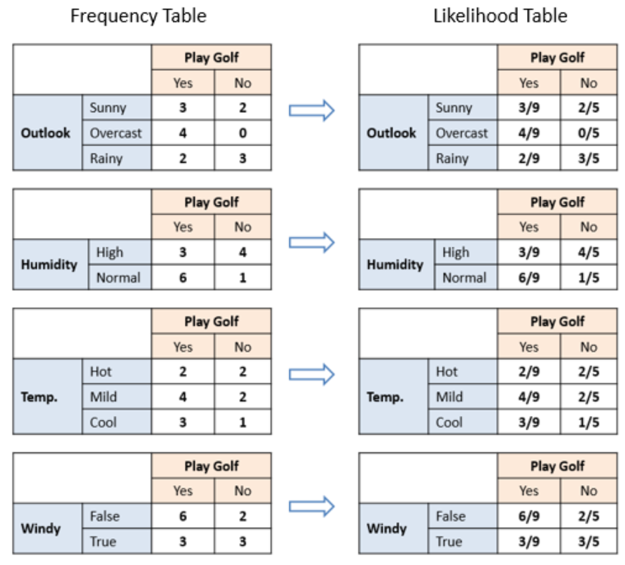

Slide 9
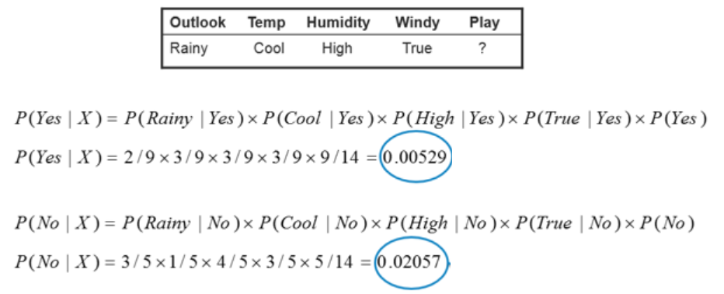
Prediction on test data

Slide 10

Naïve Bayesian Classifier Algorithm
Input: Given a set of k mutually exclusive and exhaustive classes C = $\left\{c_{1},c_{2},…..,c_{k}\right\}$, which have prior probabilities P(C₁), P(C₂),….. P(C_{k}).
There are n-attribute set A = $\left\{A_{1},A_{2},…..,A_{n}\right\},$ which for a given instance have values $A_{1}$ = $a_{1}$, $A_{2}$ = $a_{2}$,….., $A_{n}$ = $a_{n}$
Step: For each $c_{i} ∈C$, calculate the class condition probabilities, i = 1,2,…..,k
$p_{i}=P\left(C_{i}\right)\text{×}\prod_{j=1}^{n}{P(A_{j}= a_{j}|C_{i}})$
$$p_{x}=\max\left\{p_{1},p_{2},…..,p_{k}\right\}$$
Output: $C_{x}$ is the classification

Slide 11
Naïve Bayesian Classifier Pros and Cons
Pros
simple and easy to implement
doesn’t require as much training data
handles both continuous and discrete data
fast and can be used to make real-time predictions
not sensitive to irrelevant features
Cons
  assumption of independent predictors
  zero frequency problem

Slide 12
Summary
Naive Bayes is a probabilistic supervised learning algorithm
Based on the independence assumption . Called “Naïve” because of this assumption
Uses prior knowledge with observed data
Training and testing is very easy and fast
Generative classifier model

Slide 13
Reference
  Data Mining: Concepts and Techniques, (3rd Edn.), Jiawei Han, Micheline Kamber, Morgan Kaufmann, 2015.
  Introduction to Data Mining, Pang-Ning Tan, Michael Steinbach, and Vipin Kumar, Addison-Wesley, 2014

